Slide 1
Role of PSQCA in Halal Food Standardization
Dr. Shahzad Afzal
Director
Pakistan Standards & Quality Control Authority
Ministry of Science & Technology

Slide 2
Pakistan’s Quality Infrastructure
Standards
Pakistan Standards & Quality Control Authority
Conformity Assessment
(Metrology, Testing, Certification and Accreditation)
National Physical and Standards Laboratory
Pakistan National Accreditation Council
Pakistan Standards & Quality Control Authority
Certification Bodies (Public and Private)
Inspection Bodies (Public and Private)
Testing Labs (Public and Private)
Regulators

Slide 3
Background of Halal Food Standardization
As the National Standards Body, PSQCA is mandated to develop, implement, and coordinate standardization activities in Pakistan. It is primarily involved in standards development, product certification, and standards implementation/promotion to raise the quality and global competitiveness of Pakistani products at the same time to protect the interests of consumers and businesses.
The Trade Policy 2008-09 of Pakistan entrusted MoST to devise and enforce Halal Standards and certification mechanism for export of Halal food products.

Slide 4
OIC STANDARDIZATION EXPERTS GROUP (SEG) ON THE DEVELOPMENT OF THE OIC HALAL FOOD STANDARD AND THE PROCEDURES
OIC Halal Standard- General Guidelines on Halal Food
Guidelines for Bodies Providing Halal Certification
Guidelines for the Authorized Accreditation body Accrediting Halal Certification Bodies

Slide 5
PSQCA’s Halal Food Technical Committee
PSQCA established Technical Committee on Halal Food Standards in harmony with OIC Halal Standard.
PSQCA Technical Committee conducted series of meetings from February 2008 to January 2010 and consolidated the results of these consultations into PS Halal Food Standards in accordance with ISO guide 69:1999 Harmonization stage code system-Principles and guidelines for use, ISO/IEC guide 59 Code of Good Practice for standardization, and ISO Directives. Committee also harmonized these standards with OIC Halal Standards.
PS 3733: 2010 Pakistan Standards for Halal Food Management Systems: Requirements for any organization in the food chain (Ist Revision)
PS 4992:2010 Pakistan Standard for General Criteria for the operation of halal Certification Bodies

Slide 6
Halal Certification Bodies Accreditation Scheme
Halal Certification Bodies
Any Organization in the food Chain
PS 3733: 2010 Halal Food Management Systems: Requirements for any organization in the food chain
PS- 4992:2010 General Criteria for the operation of Halal Certification Bodies

Slide 7
Salient Features of the PS 3733: 2010 Pakistan Standards for Halal Food Management Systems: Requirements for any organization in the food chain
Scope
This Islamic Republic of Pakistan Standard defines the requirements for ‘Halal food safety management system’ that shall be followed during preparation, processing, packaging, labelling, handling, distribution, serving and the overall aspects of the premises dealing with and storing Halal food and its products. This Standard shall be used together with the laws of Islamic Republic of Pakistan and other relevant standards and guidelines for local/import/export purposes. It is applicable to all organizations, regardless of size, which are involved in any aspect of the food chain and wish to implement systems that consistently provide safe Halal products. The means of meeting any requirements of this Pakistan Standard can be accomplished through the use of internal and/or external resources.

Slide 8
Salient Features of the PS 3733: 2010 Pakistan Standards for Halal Food Management Systems: Requirements for any organization in the food chain
This Standard specifies requirements to enable an organization to:
a) plan, implement, operate, maintain and update a Halal food safety management system aimed at providing products that are Halal and are safe for the consumer according to their intended use;
b) demonstrate compliance with Sharia rules;
c) demonstrate compliance with applicable statutory and regulatory food safety requirements;
d) effectively communicate Halal food issues to their suppliers, customers and relevant interested parties in the food chain;
e) ensure that the organization conforms to its stated Halal food policy;
f) seek certification or registration of its Halal food safety management system by an external organization, or make a self-assessment of conformity to this Pakistan Standard.

Slide 9
Salient Features of the PS 3733: 2010 Pakistan Standards for Halal Food Management Systems: Requirements for any organization in the food chain
0.0 Forward
1.0 Scope
2.0 Normative References
3.0 Definitions
4.0 Halal Food Management System
4.1 General requirements
4.2 Documentation requirements
4.3 Emergency preparedness and response
4.4 Internal Audit
4.5 Management review
4.6 Human resources
4.7 Halal Control Points
5.0 Requirements for any organization in the Halal food chain
5.1 Sources of Halal foods and drinks
5.2 Slaughtering
5.3 Health Inspection of Carcass and Giblets

Slide 10
Salient Features of the PS 3733: 2010 Pakistan Standards for Halal Food Management Systems: Requirements for any organization in the food chain
6.0 Halal Product manufacturing, processing, handling, storage, transportation and distribution
6.1 All processed food is Halal if it meets the following requirements:
6.2 Devices, utensils, machines and processing aids
7.0 Hygiene, sanitation, and food safety
8.0 Packaging & Labeling
Informative
Annex A: Slaughtering part for cattle and method of slaughtering
Annex B: Slaughtering part for chicken and method of slaughtering
Annex C: Wet Slaughtering of poultry
Annex-D: Halal control points (HCPs) in poultry processing
Annex-E: Halal control points (HCPs)
Annex-F: Halal control points (HCPs) processed meat products
Annex-G: (Informative) Halal control points in Bread making
Annex-H: (Informative) Halal control points for salad dressing
Annex-I: Halal control points for cheese and whey
Annex-J: Gelatin production showing Halal critical points
Annex K: Islamic status for the permissibility of various food additives
Bibliography

Slide 11
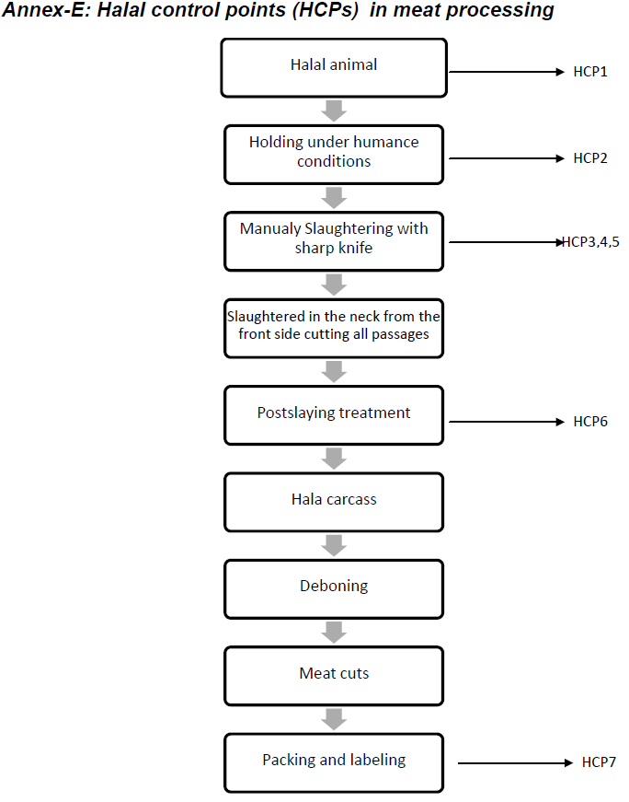

Slide 12
Salient Feature of the PS- 4992:2010 General Criteria for the operation of Halal Certification Bodies
Scope:
This standard specifies the general requirements of Halal certification bodies and conditions for its certification. The certification system used by the certification body may include one or more of the following:
Halal certificate for specific product for a specific duration—this type of certificate signifies that the listed product or products meet the Halal standard i.e., PS-Halal Food Management Systems-Requirements for any Organization in the food chain. Such a certificate may be issued for certain time period or for a specified quantity (batch certificate) of the product destined for a particular distributor or importer.
Yearly certification—may automatically be renewed subject to passing the annual inspection, through Halal compliance in accordance with PS-Halal Food Management Systems-Requirements for any organization in the food chain.
This National Standard specifies requirements enable an organization to seek accreditation of its Halal certification management system (product certification system) by an external organization.

Slide 13
Salient Feature of the PS- 4992:2010 General Criteria for the operation of Halal Certification Bodies
0.0 Foreword
1.0 Scope
2.0 Normative References
3.0 Definition
4.0 Administrative requirements
5.0 Structure
6.0 Impartiality
7.0 Management
8.0 Personnel
9.0 Nonconformities
10.0 Internal Audits
11.0 Management Reviews
12.0 Application for Halal Certification
13.0 Preparation of Assessment and Decision Making
14.0 Complaints and Appeals
15.0 Surveillance and Reassessment
16.0 Suspending, withdrawing or reducing Certification
17.0 Responsibilities of the Certification Body and the Client
18.0 Complaints to suppliers
Annex-A: Certification Process (Informative)
Annex-B: Criteria for Shariah Advisors of Certification Bodies (Informative)
Bibliography

Slide 14
Challenges
Awareness of PS 3733: 2010 and PS 4992:2010 for harmonized implementation to all food sectors, certification bodies & Islamic centres.
The need for the government to provide support infrastructure facilities required in the Halal Industry Development, such as laboratory equipment and facilities
Human Resource capacity building

Slide 15
Thanks

